Slide 1
Finding What You Need For Your Fourth Year Project
Technology Libraries Team
Notes:
PERSON 1
- All materials will be shared with you after the session. Mention Accessibility write up.
- Introduce both team members who will be delivering the session
- Can ask questions at any time.

Slide 2
Structure of Today's Session
Plan
Do
Next Steps
Notes:
PERSON 1
Aim for Session - How to plan a lit search
- How to do a lit search
- The next steps for your literature search
How to know when to stop searching
How to connect the info you have gathered from your lit search
How to acknowledge and limited bias within your search results.
How to keep up to date with new information in your research area
What support and help is available and where to access/find it

Slide 3
You HAVE to look at the literature
Notes:
PERSON 1
You do actually have to do a literature search. You won’t be able to do your project without on.

Slide 4
Provide context
Explore similar & related topics
Assess current knowledge
Why we search academic literature?
Refine scope of your work/research
Discover what knowledge is current unknown
Notes:
PERSON 1
Why we search academic literature? Basically what’s the point.
Provide context on the area we are studying/researching
Assess the current knowledge in a given area
Discover what knowledge is currently unknown. Where are the gaps in the field. This is helpful to identify possible areas for research.
Refine the scope of your study/research. Breaking an area down.
Explore similar and related topics. How your area relates to other areas.

Slide 5
Plan Early…
It saves you time later!
Notes:
PERSON 1
Section 1: Planning your Literature Search

Slide 6
Which one have you been asked to do?
Literature Search
Literature Review
Piece of work in its’ own right
Survey of relevant literature on a given subject
To write a review you perform a literature search
Synthesis & summarise information
Critical analysis of information
Standard & organised format
Process of searching for information
Formal or informal
Helps you to write later
Notes:
PERSON 1
What is the difference between a literature search and a literature review? They are different.
Make sure you know which one you are have been asked to do.
You might start doing a literature search and then move into a literature review. You can’t do a literature review without having done a literature search.

Slide 7
Step 1: Understand
Step 2: Scope
Step 3: Develop
PLAN STAGE: Set up a Search Strategy
Step 4: Shape
Step 5: Record
Notes:
PERSON 1
Explain the importance of a search strategy.
Search strategy = process/approach to complete search
Explain how to plan a search.
Step 1: Understand what you are searching for.
Step 2: Scope out your subject area to identify keywords/phrases/questions.
Step 3: Develop the keywords you have identified whilst scoping your subject area.
Step 4: Decide which shape of search you are going to do.
Step 5: Recording you search
Going to look at all these steps in detail.

Slide 8
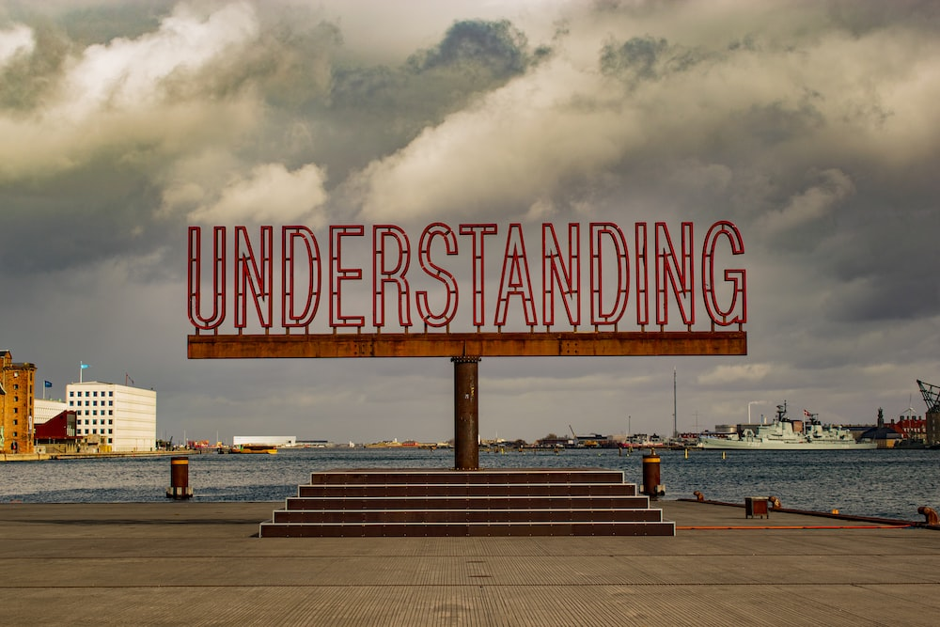
Step 1: Understand
Make sure you understand WHAT you are searching for and WHY.
Notes:
PERSON 1
What is the question REALLY asking you? Have you read the question properly? Do you understand all the terms in the question etc.
What do you need to be able to do with the results from your literature search? Write a report, give a presentation etc.
Are you actually looking for literature would running a Google image search actually help with finding out how

Slide 9
Step 2: Scope
Scope out your subject area to identify keywords/phrases/questions.
Notes:
PERSON 1
Put all your keyword/phrases/questions down somewhere. A popular method is a Mindmap.
We are going to show you how these search planning steps work with a worked example (automation in beer production)

Slide 10
Step 2: Worked Example
Keywords: Automation / Beer / Production
Notes:
PERSON 1
Talk through

Slide 11
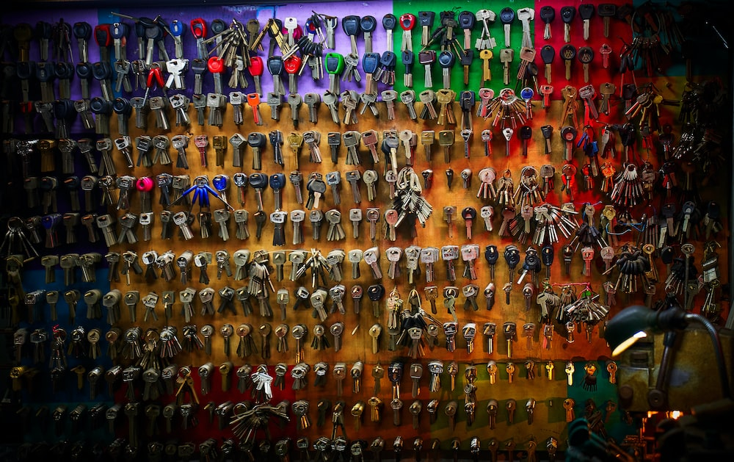
Step 3: Develop
Develop the key words from Step 2. Think of synonyms, abbreviations, alternative spellings.
Notes:
PERSON 1
Look at the keywords on your Mindmap. This will help you get the most relevant search results when it comes to doing your literature search.
Mention:
synonyms, acronyms, abbreviations, and alternative spellings
Boolean Logic
Google + Wikipedia ( remember don’t use in search but to build)

Slide 12
Step 3: Worked Example
Production
Manufacture
Fermentation
Automation
Manufacturing
Automated
Mechanisation
Industrialised
Beer
Mechanization
Industrialization
Ale
Notes:
PERSON 1
Talk through

Slide 13
Step 3: Develop
Identify type of search a databases uses
Lexical
Semantic
Smart Search/Neural Search
Human-like Understanding
Acronyms
Related Words
Question in Sentence Form
Traditional
Alternative Spellings
Words with Same Stem
Develop Your Keywords

Slide 14
Step 4: Shape your Search
Decide on a structure for you search
Notes:
PERSON 1
Detail on Step 4 - Decide which shape of search you are going to do.
3 shape options:
Top-down: general to detail
Bottom-Up: detail to general
Citation Trail: follow the trail of linked literature via bibliographies and citations
Mention: moving forwards and backwards in time.

Slide 15
Step 5: Record
When
How
Where
Date of the search
Search terms used and in what order
Which source
Where you found it
Notes:
PERSON 1
Links to managing your data
When = date
Where = source info
How = words used to create result
Can use lab books / notebook / research diary

Slide 16
Step 5: Worked Example
Date | Search Term | Source | Literature Found
16/9/2022 | Automation in beer production | iDiscover Prague: Czech Academy of Agricultural Sciences (CAAS) Czech Journal of Genetics and Plant Breeding, 2011, Vol.40 (No. 4), p.137-139 | Barley Varieties Suitable for Production of the Czech-type Beer, by Kosař, K. ; Psota, V. ; Mikyška, A.
16/9/2022 | Beer and Production and Automated | Scopus Lecture Notes in Mechanical Engineering pp. 511-521 | Implementation of Autonomous Maintenance and Its Effect on MTBF, MTTR, and Reliability of a Critical Machine in a Beer Processing Plant, by Mohamed, A., Ben, J., Muduli, K.
Notes:
PERSON 1
Talk through

Slide 17
Need help with referencing?
Don’t worry, we are here to help.
Notes:
PERSON 1
Good recording of your literature search will help you with referencing when you are writing.
If you need help with Referencing let us know;
We run referencing sessions (beginner and refresher)
Cite Them Right

Slide 18
Activity 1
Have a go at scoping the keywords to the question:
How can artificial intelligence be used to improve pizza delivery?
Call out any keywords/areas you can think of.
Notes:
PERSON 1
Practical Activity 1 – Time 5 mins
Room to scope a search for - Artificial Intelligence in Pizza delivery
Then develop keywords
Room to call out answers and you to add them to flipchart/whiteboard.

Slide 19
Activity 1: Example
Pros and Cons of this technology
What do the big delivery companies use?
What can we learn from them?
What technology is already used in food delivery?
What other similar industries use AI? i.e Logistics
Artificial Intelligence in Pizza Delivery
What are the issues within the current food delivery process?
What new development in AI have there been?
How could they work within food delivery?
Notes:
PERSON 1
This is a keyword scope Mindmap which we came up with.
(If needed here is a completed scope for the topic. Use for modelling if needed. )

Slide 20
Apply keywords
Google Scholar
iDiscover
DO STAGE: Where to find what you need
Databases
The Web
Notes:
PERSON 2
Section 2: Doing your Literature Search
Where to start searching;
Google Scholar with Library Links.
Ask room what they use iDiscover for
Go into more depth on databases

Slide 21
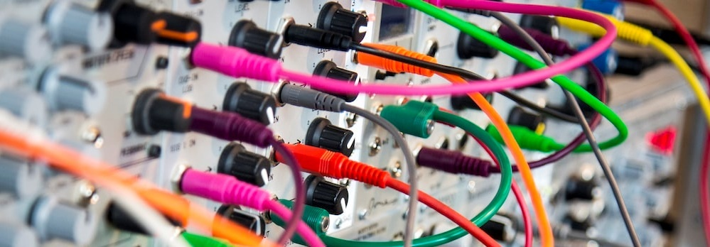
Apply keywords
Word Order
Boolean Operators
Notes:
PERSON 2
So we have planned our search and identified some keywords. Now we need to think about how we are going to use them.
The order in which you place words in a search can effect the results that you get; that is why it is helpful to try multiple configurations.
It can also be helpful to used Boolean operators in conjunction with your keywords to make your search results more specific.
Here it is really important to record each search you do so that you don’t search for the same thing twice but also to learn from the success of your previous searches.

Slide 22
Boolean Operators
AND
OR
NOT
Narrow
Connect
Exclude
Notes:
PERSON 2
If you don’t know what Boolean operators are then….
3 main ones
And: the narrow your search but asking for both keywords to be included in results
Or: connect results (often useful to use when a word has different spelling variations
Not: this excludes results. For example beer production not manual.

Slide 23
Google Scholar
Remember to Set Up Library Links
Notes:
PERSON 2 Talk
Where is the first place that everyone searches for anything – Google
This can be used for academic literature do – bring in Google Scholar
PERSON 1 drive the mouse for the live demo
Live demo of Google Scholar – with setting up library links and searching for ‘beer’ to show what a library linked article looks like.

Slide 24
iDiscover
Notes:
PERSON 2 Talk
PERSON 1 Drive the mouse in live demo
Live demo of iDiscover
iDiscover: live demo each radio button using the worked example
Cambridge Libraries Collection – title level book and journal results
Articles and online resources – book and journal article titles
Search everything – filters limited/ things Cambridge doesn’t even have

Slide 25
Databases
Notes:
PERSON 2 Talk
PERSON 1 Drive the mouse in live demo
Live demo continued
Database A-Z live demo Engineering then Scopus or Web of Science
Chose subject
Best bets + A-Z for subject
Direct link to database
Find article on database for beer production

Slide 26
Databases
Notes:
PERSON 2 Talk
PERSON 1 Drive the mouse in live demo
Live demo continued

Slide 27
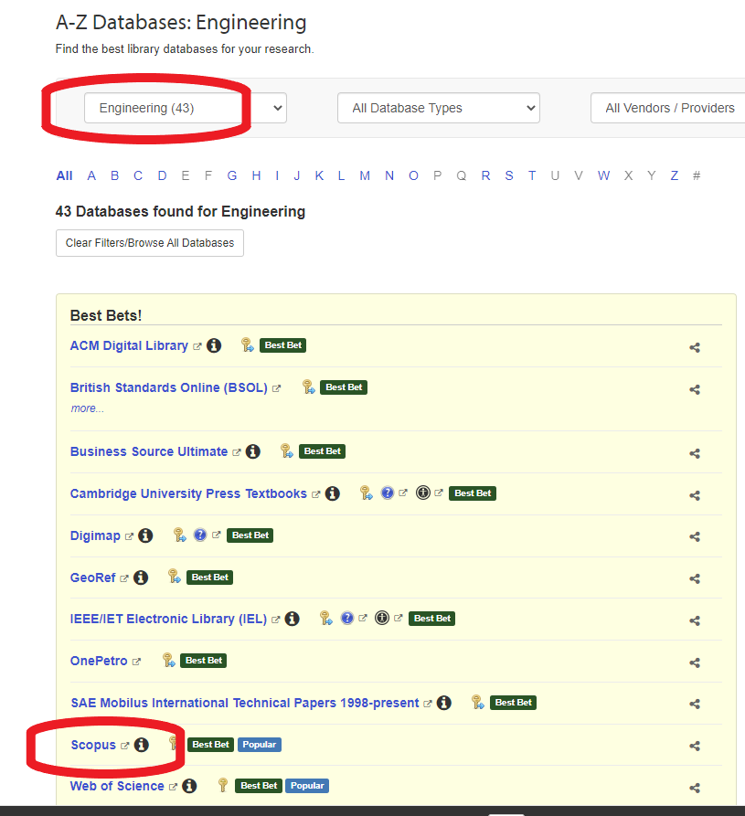
Databases
Notes:
PERSON 2 Talk
PERSON 1 Drive the mouse in live demo
Live demo continued

Slide 28
The Web
Browser extensions to get you behind paywalls to the full text when searching online
Notes:
PERSON 2
Browser Extension/Plug Ins
Lean Library
LibKey Nomad
Good for finding open access material/material freely available online/off campus/useful for web searching
Instructions links are available in your session write up.
Live demo using worked example. Google with these enabled.

Slide 29
Activity 2
Have a go at doing a literature search:
How can artificial intelligence be used to improve pizza delivery?
Google Scholar
iDiscover
Database – Web of Science or Scopus
Remember to record you searches in your search log
Notes:
PERSON 2
Practical Activity 2 – Time 8 mins
Room to individually perform a search using the keywords identified in Activity 1
Each person needs own internet enabled device.
Get people to chose to perform a search on Google scholar or iDiscover or Database
They need to record searches in the Search Log Template (give out to everyone)
Brownie points for the best title found from a search.

Slide 30
Activity 2: URL’s
How can artificial intelligence be used to improve pizza delivery?
Google Scholar
http://scholar.google.com
iDiscover
https://idiscover.lib.cam.ac.uk
Notes:
PERSON 2
Leave this slide up during Activity 2 – these are the URL’s attendees will need for the activity.
Let them know when they only have a few mins left.
Remind them about recording in the Search Log

Slide 31
NEXT STEPS
Notes:
PERSON 1
Section 3: Next Steps for your Literature Search
These are the areas we are going to talk through.

Slide 32
Bias
Why
Be Critical
Corroborate
Use Multiple Search Locations
AI-based tool biases
When
Where
Who
Notes:
PERSON 2
How to do this;
Think about: when the source was written, whom wrote it, where it was published, why it was written.
Be critical
Try to corroborate information using multiple sources
To avoid bias, consciously search for material across multiple search locations.

Slide 33
When to Stop Searching
Repetition in your Search Results
Your Key Ideas Confirmed
Up To Date with the Latest Research
You’ve answered the question!
Notes:
PERSON 1
When to stop searching
Repetition
Key ideas & authors
Up to date
Answered question

Slide 34
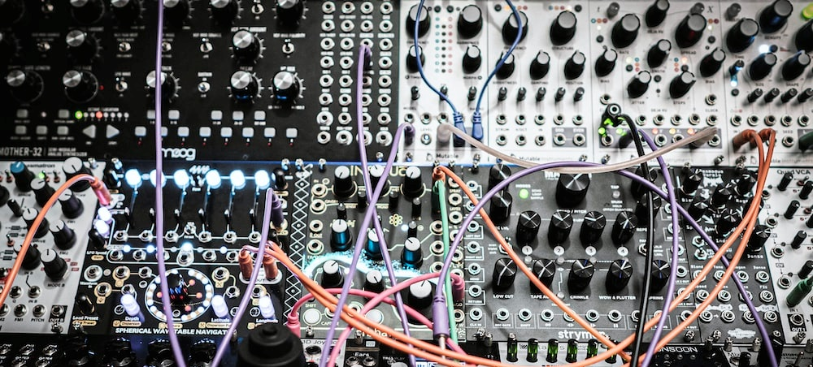
Making Connection between Sources
Making Connections = Synthesising
Notes:
PERSON 1
Making Connections between Sources
Sometimes referred to as synthesising.
A record of how your reading has built you understanding over time. How items you have read relate and act in dialogue with each other.
Highlight Moodle course or CLIC if you are from Eng
Explain the grid method + template (use Meg’s template)

Slide 35
Activity 3
Can you make some connections between these films?
Call them out.
Notes:
PERSON 2
Practical Activity 2 – Time 8 mins
As a room/small group come up with themes and links between the films.
Put them on a whiteboard/flipchart
They will be provided with a completed synthesising grid at the end of the activity to model this. Give this out at end of activity

Slide 36
Key Points to Remember…
Plan
Do
Step 1: Understand
Step 2: Scope
Step 3: Develop
Step 4: Shape
Step 5: Record
Apply Keywords
Google Scholar
iDiscover
Databases
The Web
Stop
Make Connections
Notes:
PERSON 1
Summary of key points from session:
Reiterate
Plan
5 steps to planning a literature search
Do
Use multiple locations for your search
When to Stop Searching
- Repetition / answered question / up to date
Making Connections between Sources
- Importance of good note making
- Use the grid method

Slide 37
Getting in Touch
Feedback form: https://bit.ly/techlibfeedback
Email: techlib@lib.cam.ac.uk
Website: libguides.cam.ac.uk/technologylibraries
Notes:
PERSON 1
Ways to contact us.
Our website has lots of useful info about literature searching and other topics.
Attendees to complete feedback form

